Slide 1
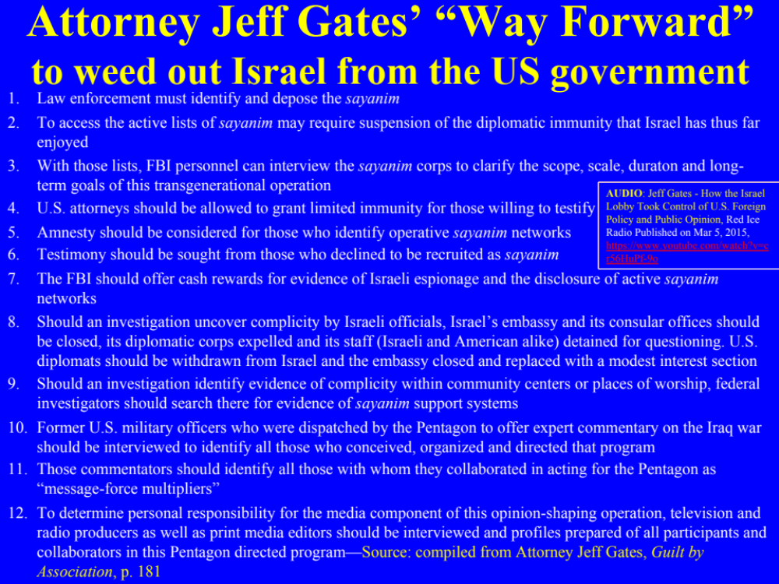

Slide 2
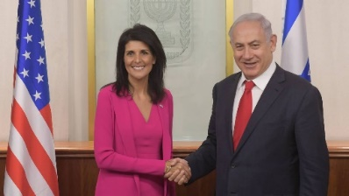
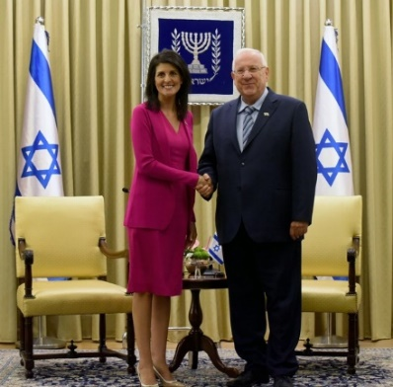
http://www3.pictures.zimbio.com/gi/ambassador+UN+Nikki+Haley+meets+Israeli+President+6g_X9dboZGtl.jpg
Israel Prime Minister Netanyahu: I Told American UN Envoy Nikki Haley UNRWA Should Be Dismantled, Haaretz, 6/11/2017, https://www.haaretz.com/israel-news/1.795006
US ends all funding to UN agency for Palestinian refugees (UNRWA),
CNN, 8/3/2018, https://www.cnn.com/2018/08/31/politics/trump-administration-ending-funding-palestinian-refugees/index.html ; https://www.youtube.com/watch?v=6uIfKGuFaEU
Adelson’s political beneficiaries adopt casino magnate’s cause
to ban Internet gambling, The Washington Post, 5/7/2014, https://www.washingtonpost.com/politics/adelsons-political-beneficiaries-attack-casino-magnates-bete-noire-internet-gambling/2014/05/07/7ff15aba-cf1a-11e3-937f-d3026234b51c_story.html
All 100 U.S. Senators Demand UN Take Action Against ‘anti-Israel Agenda’, Haaretz, 4/28/2017, https://www.haaretz.com/us-news/1.786229
Israel Prime Minister and Israeli President Meet US Ambassador to the UN Nikki Haley, Published on Jun 7, 2017, https://www.youtube.com/watch?v=eFTGm0pMQ_o
Nikki Haley’s U.N. mission: Sticking up for Israel, CBS, 2/16/2018, https://www.cbsnews.com/news/nikki-haleys-un-mission-sticking-up-for-israel/
Nikki Haley told the AIPAC conference: "I wear heels. It's not for a fashion statement. It's because if I see something wrong, we're going to kick them [Israel's bashers] every single time," Published on Apr 8, 2017, https://www.youtube.com/watch?v=C99BJULoNtc
Netanyahu Unaware of the Camera 'America can easily be moved', Published on Sep 29, 2012, https://www.youtube.com/watch?v=JrtuBas3Ipw
The Occupation of the American Mind: Israel's Public Relations War in the United States, Narrated by Roger Waters, http://mediaed.org/occupationmovie/
Jeff Gates - How the Israel Lobby Took Control of U.S. Foreign Policy and Public Opinion, Published on Feb 21, 2015, https://www.youtube.com/watch?v=hUJx1dVX45s
Trump and Allies Seek End to Refugee Status for Millions of Palestinians: Jared Kushner, U.S. President Donald Trump’s son-in-law and senior advisor, has quietly been trying to do away with the U.N. relief agency that has provided food and essential services to millions of Palestinian refugees for decades, according to internal emails obtained by Foreign Policy. Foreign Policy, 8/3/2018, https://foreignpolicy.com/2018/08/03/trump-palestinians-israel-refugees-unrwaand-allies-seek-end-to-refugee-status-for-millions-of-palestinians-united-nations-relief-and-works-agency-unrwa-israel-palestine-peace-plan-jared-kushner-greenb/

